Slide 1
Expereo Introduction presentation

Slide 2

Expereo Introduction
Incorporated in 2004, with headquarters in Netherlands, and regional presence in USA, Singapore, Dubai, Argentina
Expereo is the global leader in local internet access services with global coverage and a global enterprise installed base in more than 200+ countries
Pure wholesale model: no competition with our clients
Provide one contract, one bill, one currency while managing 2000+ providers/integrators across 200+ countries to support our customers
Expereo Value: Helping global enterprises reduce overall cost of ownership of managing a global network and business
Our Mission
To help connect you, anywhere on the planet!

Slide 3
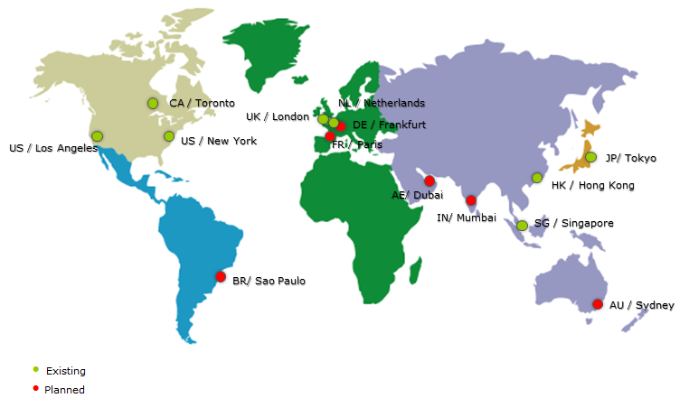
Global Operations

Slide 4
True Global Coverage
Africa | Asia Pacific | Eastern Europe | Western Europe | North America | South America
Algeria | Australia | Albania | Andorra | Canada | Argentina
Angola | Bangladesh | Armenia | Austria | United States | Bolivia
Burkina Faso | Bhutan | Azerbaijan | Belgium | United States (Alaska) | Brasil
Cameroon | Brunei Darussalam | Belarus | Cyprus | United States (Hawaii) | Chile
Congo | Cambodia | Bosnia and Herzegovina | Denmark |  | Colombia
Djibouti | China | Bulgaria | Faroe Islands | Central America | Ecuador
Egypt | East Timor | Croatia | Finland | Barbados | French Guiana
Equatorial Guinea | Fiji | Czech Republic | France | Bermuda | Guadeloupe
Ethiopia | French Polynesia | Estonia | Germany | Costa Rica | Guyana
Gabon | Guam | Georgia | Greece | Dominican Republic | Paraguay
Ghana | Hong Kong | Hungary | Guernsey | El Salvador | Peru
Guinea-Bissau | India | Kazakhstan | Iceland | Guatemala | Uruguay
Ivory Coast | Indonesia | Kyrgyzstan | Ireland | Haiti | Venezuela
Kenya | Japan | Latvia | Isle of Man | Honduras
Libya | Laos | Lithuania | Italy | Jamaica | Middle East
Madagascar | Macau | Macedonia | Jersey | Martinique | Afghanistan
Malawi | Malaysia | Moldova | Liechtenstein | Mexico | Bahrain
Mauritania | Maldives | Montenegro | Luxembourg | Netherlands Antilles (Aruba) | Iran
Mauritius | Mongolia | Poland | Malta | Panama | Israel
Mozambique | Myanmar | Russia | Netherlands | Puerto Rico | Jordan
Niger | Nepal | Serbia | Norway | Trinidad and Tobago | Kuwait
Nigeria | New Caledonia | Serbia (Kosovo) | Portugal | Virgin Islands (U.S.) | Lebanon
Reunion | New Zealand | Slovakia | Spain |  | Oman
Senegal | N. Mariana Islands | Slovenia | Sweden |  | Palestine
Seychelles | Pakistan | Tajikistan | Switzerland |  | Qatar
South Africa | Papua New Guinea | Ukraine | Turkey |  | Saudi Arabia
Sudan | Philippines | Uzbekistan | United Kingdom |  | Syria
Tanzania | Singapore |  |  |  | United Arab Emirates
Tunisia | South Korea |  |  |  | Yemen
Uganda | Sri Lanka
Zambia | Taiwan
 | Thailand
 | Vietnam

Slide 5


























used by ALL major Global carriers/Integrators

Slide 6






































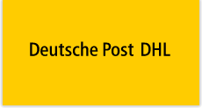




















Some Expereo Global End Customers
Consumer Packaged
Goods
Global
Commerce
Global Banking &
Financial Marketing
Government &
Health
Other Customers:

Slide 7






Product overview
Internet
Ethernet
iVPN
Dedicated and Broadband Internet Access for Carriers and Integrators
All Internet services include onsite installation, Ethernet handoff and standard or premium SLAs.
MEF compliant Ethernet Virtual Private Line and Ethernet Private Line
Access to all key local networks and handoff through E-NNI, possible in all key data centers around the world.
Any to any DM-VPN based Internet VPN
VPN tunnel handoff at NNI in one of our global POPs, or at one or multiple Gateways located at end customer locations.
Managed WiFi
Hardware
Professional
Services
A fully managed global Guest Access WiFi solution
Including Internet access, security, user access management and fully separated from the end customer’s WAN and LAN.
Equipment with onsite maintenance (break-fix)
Delivery, installation and maintenance (break-fix) of (un)managed routers, switches, NIDs and WiFi equipment.
On-site technician for professional services
Design, implementation and on-site field tech services including services such as installation, maintenance and in-house cabling.

Slide 8
Global Internet
Any access technologies across 200+ countries
Broadband – xDSL, Cable, 3G/4G/LTE up to 150megs
Dedicated Internet Access – copper, fiber, ethernet up to 10Gigs
Manage 200 providers in US alone and 2000+ providers
Can provide full end to end compliment of DMVPN NNI for MPLS
Fully Managed Service
Standard Ethernet RJ 45 handoff globally for ease of transition and management
Always at least /30 static public IP addressing for you to use
Full global installation/provisioning management and post support
Only business grade services
All services fully managed, monitored, supported 24/7
Customer Case: Providing global internet access across 70+ countries for P&G to more than 500 sites supporting manufacturing plants, sales offices, remote sites

Slide 9
Global Data center Internet
Any access technologies to any data center globally
Expereo GDCI product provides competitive local IP for any data centers around the world that Masergy may not have coverage
Get fit for global enterprise who requires a lot of cloud applications, data centers, and regional hubs
Fully Managed Service
Standard Ethernet RJ 45 handoff globally for ease of transition and management
One bill, currency, support, provider for all data centers
Strong SLA supporting data center applications
Diversity options in data centers available
All services fully managed, monitored, supported 24/7
Customer Case: Providing global IP to 20+ different data centers around the world for ServiceNow to support cloud service and communication between data centers

Slide 10
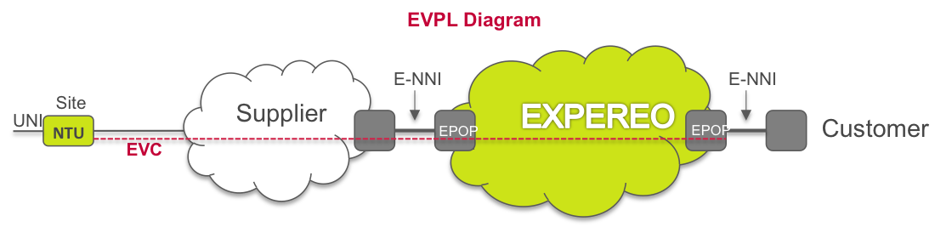
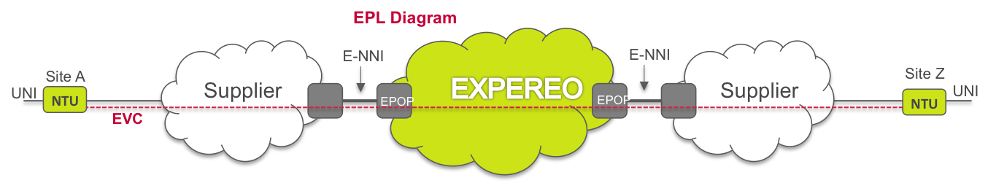
Ethernet
Fully transparent layer-2 Carrier Ethernet based local access service, providing access to all key networks in a market.
  Ethernet Virtual Private Line (EVPL) Site to E-NNI
  Ethernet Private Line (EPL) Site to Site
Multiple access technologies: EoFiber, EoSDH/SONET, EoCopper.
Speeds and contention ratios dependent per country / provider / service.
Class of Service and SLA on Time To Deliver and Time To Repair.
Available in Expereo POP countries (ICB outside POP countries).
Monitoring Portal providing access to real time analytics (availability, frame delay, frame loss ratio, throughput).

Slide 11
Hardware & Professional Services
Hardware
All Cisco Routers, Switches
Including 8x5xNBD Onsite maintenance (24x7x4 optional)
Coverage > 200+ countries
Differentiator: source locally avoiding import, taxes, customs for faster delivery
Customer Case: Help provide routers globally for Pfizer with 24/7 NBD support.
Professional services
On-site field tech services (incl. installation, maintenance, cabling, etc.)
Feet on street with coverage > 200+ countries
Differentiator: Very competitive rates of $250/hr, min of 2 hours globally
Customer Case: Helping Visa and MasterCard with LAN work so their engineers didn’t have to fly out to site.

Slide 12

iVPN
iVPN is a fully managed hybrid any-to-any “internet Virtual Private Network” service to securely connect multiple end-customer sites together using DM-VPN*
  Internet access + VPN router on remote sites (end points) + Tunnel management.
  Online remote management via portal available to customers / end-customers
Two designs:
  Head-end: connecting all remote sites to a head-end (e.g. at HQ or DC)
  NNI: connecting all remote sites to a NNI (interconnect) with Customer
POPs in the USA (New York (2), Los Angeles and Ashburn), Canada (Toronto), UK (London), Netherlands (Amsterdam (2)), Germany (Frankfurt), Hong Kong, Singapore, Japan (Tokyo) and Australia (Sydney).
Coverage in 200+ countries.
Typical Applications:
Cost-efficient, flexible and highly resilient alternative VPN solution compared with MPLS VPNs
Hybrid solution (VPN connectivity + local Internet breakout)
iVPN

Slide 13




End-to-End Managed WiFi Service
Expereo fully managed Wi-Fi service for Guest Access and Employee Access and Bring Your Own Device (BYOD).
24/7 support by redundant Network Operations Centers in Amsterdam and Singapore
Fully separated from end customer LAN and WAN
Help reduce cost of management, ownership, and liability for global enterprises
Available in 200+ countries
WLAN
(Wireless Local Area Network)
Deliver, install and maintain equipment of the 3 leading WiFi vendors
INTERNET ACCESS
Fully managed Broadband or Dedicated Internet Access
Copper
Fiber
Wireless
Unprotected
Protected
SECURITY
Security using the world’s leading cloud based solution
Customer Case: Providing Exxon Global Wi-Fi to 120+ sites

Slide 14
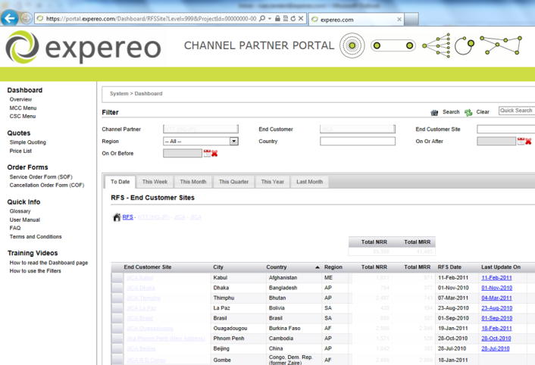
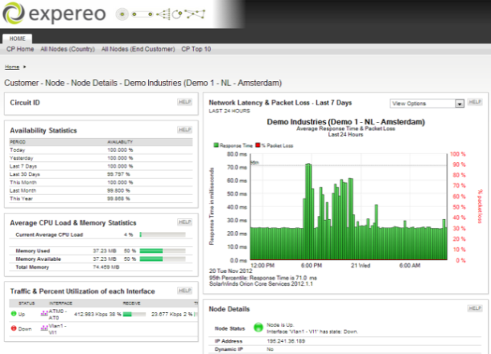

Key Support Elements
Channel Partner Portal
Network Monitoring
Network Support
Quotations and pricing details at your fingertips
Inventory of all site information with all technical details
Up-to-date order progress information allows for pro-active customer management
Real-time ticket information on what’s up, what’s down and ticket details
Site availability details with real-time and historical data and graphs
Performance Statistics of Access and CPE allowing for technical analysis
Re-active Support. Expereo helpdesk monitors service 24x7. In case service becomes unavailable, action is taken once channel opens a trouble-ticket with Expereo.
Pro-active Support. Expereo helpdesk monitors service 24x7 and Expereo pro-actively opens a trouble ticket in case of any customer impact

Slide 15
Thank You!
Expereo Global Contact:
Victor Hou
Victor.Hou@expereo.com
Ph: +1 703-725-0672

