Slide 1

Bringing Simplicity to Technology Administration

Slide 2

Problems
You closed three offices a year ago, but nobody turned off the phone or internet for two of them, so you’ve been paying $800 per month for two empty locations
You’ve got 70 mobile phones (including older flip phones)—but only 55 employees, and many appear to be MUCH older plans (twice the cost, half the data)
Notes:
You closed three offices a year ago, but nobody turned off the phone or internet for two of them, so you’ve been paying $800 per month for two empty locations.
You’ve got 70 mobile phones (including older flip phones)—but only 55 employees, and many appear to be MUCH older plans (twice the cost, half the data).
You’ve been having disconnect problems with your phone lines—but is it the phone or a something else (hint: it’s a relic network)
And of course, you’re a master negotiator—so you’ll easily get your money back from these multi-billion dollar vendors (without being exhausted in the bureaucracy).

Slide 3

Problems
You’ve been having disconnect problems with your data network –no information going out, nothing coming in. (hint: your customers are not going to be happy)
And of course, you’ll easily get your money back from these multi-billion dollar vendors (without being exhausted in the bureaucracy)
Notes:
You closed three offices a year ago, but nobody turned off the phone or internet for two of them, so you’ve been paying $800 per month for two empty locations.
You’ve got 70 mobile phones (including older flip phones)—but only 55 employees, and many appear to be MUCH older plans (twice the cost, half the data).
You’ve been having disconnect problems with your phone lines—but is it the phone or a something else (hint: it’s a relic network)
And of course, you’re a master negotiator—so you’ll easily get your money back from these multi-billion dollar vendors (without being exhausted in the bureaucracy).

Slide 4

Alternatives
You’ve got your current spreadsheets. How’s that working for you
You could try a common Telecom Expense Management Systems, but they are grossly incomplete and only process the invoices—don’t tell you if you should even be paying them
You could combine 4-5 applications and may get the information you need (after spending $100,000 to integrate them)—but you still have to learn all the different interfaces
And You are still having problems…
Notes:
Alternatives that customers try…
Spreadsheets
Vendors
Doing nothing at all
Accounting systems
Memory
Staff
Systems/Hardware
Home grown databases

Slide 5

The Biggest Questions
So, how do you ensure you don’t pay (massively) for services you should have turned off, are getting the absolute latest and best plan for those you keep, or even know if it is time to switch your services (still using POTS and a tape answering machine, when you can save half with VoIP)—all in a single system with a dashboard that tells you what the heck is even going on?
Perhaps you should consider…
Notes:
The Big Question (thesis)
So, how do you ensure you don’t pay (massively) for services you should have turned off, are getting the absolute latest and best plan for those you keep, or even know if it is time to switch your services (still using POTS and a tape answering machine, when you can save half with Voip)—all in a single system with a dashboard that tells you what the heck is even going on?
Perhaps you should consider…
SimpleTek – we solve what ails you! 😊

Slide 6
Introducing
Bringing Simplicity to Technology Administration

Slide 7
Credibility
We know a lot because we’ve experienced a lot!
SimpleTek has been servicing customers since 1989 (29 years)
Same company that designed and implemented the National Suicide Prevention Lifeline for the US Government
Has managed over $70 million in monthly billing for businesses globally and have successfully negotiated Credits of over 45 million for billing errors
100% of customers have realized a net cost savings—even when factoring in the cost for SimpleTek. Customers include:
  AT&T
  United Way
  St Louis Blues
  Novus International
  LMI Aerospace
  Clear Channel Radio
  HOK
  Payless Shoes
  9 West Retail
Notes:
SimpleTek has been servicing customers since 1989 (29 years).
Same company that designed and implemented the National Suicide Prevention Lifeline for the US Government.
Has managed over $70 million in monthly billing for businesses globally and have successfully negotiated Credits of over 45 million for billing errors.
100% of customers have realized a net cost savings—even when factoring in the cost for SimpleTek. Customers include:
AT&T
United Way
St Louis Blues
Novus International
LMI Aerospace
Clear Channel Radio
HOK
Payless Shoes
9 West Retail

Slide 8

SimpleTek
The world’s only automated system that uses software to audit your entire company’s mobile, data and cloud services to pinpoint EXACTLY how to save thousands each month (averages 31% savings…and reduces manpower drain).
  Ensures you have the correct plan, not paying for unused lines, billed correctly, and Enterprise level expense management virtually eliminating the time and hassles of invoice processing.
  PLUS, with integration of inventories, vendor details, contracts and automation of ordering and projects administration is simple and hassle free.
Notes:
SimpleTek
The world’s only automated system that uses software to audit your entire company’s mobile, data and cloud services to pinpoint EXACTLY how to save thousands each month (averages 31% savings…and reduces manpower drain). Ensures you have the correct plan, not paying for unused lines, billed correctly, and Enterprise level expense management virtually eliminating the time and hassles of invoice processing. PLUS, with integration of inventories, vendor details, contracts and automation of ordering and projects administration is simple and hassle free.

Slide 9

Best Solution
There are five MAIN reasons to consider SimpleTek
Supports the MOST Services & Technology
BEST Mobility
BEST Vendor Administration & Contracts
BEST Reporting
EASIEST To Use
\
Notes:
There are five MAIN reasons to consider SimpleTek
Supports the MOST Services & Technology
BEST Mobility
BEST Vendor Administration & Contracts
BEST Reporting
EASIEST To Use
Plus, it is the Price Performance LEADER
Let’s look at each of these in detail

Slide 10

1) Supports the MOST Services & Technology
SimpleTek audit creates custom and pre-built database of all the technical details within your system—so you always know exactly what you have per location
  BEST Data
  BEST Voice
  One of the BEST Mobility Services
  BEST Cloud Services
  In addition, it also includes BEST Hosted Phone System, BEST Managed Services, BEST Standalone, BEST Regulatory, MOST Subscriptions, BEST Facility Utility & Services Support, One of the Highest Security, BEST Inventory & Service Management
Notes:
Supports the MOST Services & Technology. SimpleTek includes all the common service categories (voice, data, mobile, cloud and support) required to allocate expenses, process invoices and allocate to the proper group. But unlike basic “blind” alternatives, the audit creates custom and pre-built database of all the technical details within your system—so you always know exactly what you have per location. For example, how many land lines you are purchasing vs using (including the correct provider), what mobile plans do you have (and are they still the best), what data speeds are you getting (is your plan still competitive?), plus MORE.
BEST Data. Goes beyond the basics to include granular details including Service type, Circuit ID’s, IP addresses, interconnects, data speeds, etc.), interface hardware (routing details, hardware, signaling, etc.), and Utilization reports. You know exactly what you have, by location, if it is even being used (i.e., office closed—but internet still being billed), and if it is the best plan (or you’re paying old higher rates for lower speeds)—you validate that you are getting the absolute best price—drastically reducing unnecessary expenses.
BEST Voice. Includes common service types plus advanced network details found nowhere else (i.e. Access method, Network interface, signaling, Line coding, codec, etc.), service details (# of paths, routing, circuit ID’s/phone numbers, Caller ID, uses, Utilization, Call Detail records, etc.) and technology deployed (SIP, PRI, POTS, etc.). You finally know if you are still paying for unused lines, if you should switch to dedicated services, move to VoIP, bundle or un-bundle, or even use a hosted system—plus you have all the ammunition to negotiate the best deal.
One of the BEST Mobility Services. Maintains inventory of all service items (i.e. Rate plans, upgrade eligibility, usage, discounts, etc.), line/hardware details (user, device type, Apps, IMEI, SIM, etc.), and accessories/apps on a per line of service basis. Ensures you have the best plan (every 13 hours there are plan changes—many can save you thousands), take advantage of hardware promos, turn off unused lines, and helps isolate abuses (data overage, downloaded unapproved apps, etc.).
BEST Cloud Services. SimpleTek identifies and evaluates your dedicated or shared servers, web services, Azure, Hosted solutions (UCaaS, PBX, MS365, etc.) and many more. It automatically benchmarks, then reports bottlenecks and makes reconfiguration or new system recommendations—many that will increase capability and speed without having to purchase new systems (better utilize what you have), often saving thousands.
In addition, it also includes BEST Hosted Phone System, BEST Managed Services, BEST Standalone, BEST Regulatory, MOST Subscriptions, BEST Facility Utility & Services Support, One of the Highest Security, BEST Inventory & Service Management.

Slide 11

2) BEST Mobility
SimpleTek combines the BEST features of Mobile Expense Management (MEM) and Mobile Device Management (MDM) with inventory and user administration providing the ability to administer all facets of mobile management through a single platform
  Best MEM
  Most MDM Integrations
  Best Mobile Administration
Notes:
BEST MOBILITY - SimpleTek combines the best features of Mobile Expense Management (MEM) and Mobile Device Management (MDM) with inventory and user administration providing the ability to administer all facets of mobile management through a single platform.
Best MEM. Automates basic invoice processing, such as verifying bill accuracy, but it also conducts an automatic deep dive review of available rate plans, association discounts, device centric pricing and other hidden price concessions (that the service provider seldom tells you about)—ensuring you have the BEST price.
Most MDM Integrations. The only system that integrates with all popular MDM platforms like Microsoft Intune, Airwatch, Kaseya, Spiceworks, and SOTI for quick and easy administration through a single platform. You can lock down a device in seconds when an employee leaves, enable stronger security policies, AND implement a BYOD policy without compromising the company’s confidential information.
Best Mobile Administration. Maintains an accurate inventory of all current mobile services and hardware, including phone numbers, user assignments, device details, rate plans, contracts, apps, and upgrade eligibility. Enables you to reassign devices instead of buying new ones, change device statuses when someone travels international or change the plan on a line no longer being used, stop mobile device abuses (like home video streaming through company phone), PLUS you can activate phones quicker and swap SIM cards instead of waiting for new ones.

Slide 12

3) BEST Vendor Administration & Contracts
STRONGEST Contract Management. -- The software auto-notifies you in advance of end of contract or auto-renewal dates, so you can re-evaluate or re-negotiate your options and services if desired, often saving 10% to 25% (especially if not under contract)
  With Comprehensive Vendor Profiles
  Best Order Administration
  Rate Guide Analysis
Notes:
BEST Vendor Administration & Contracts
Comprehensive Vendor Profiles. The extensive vendor library provides valuable insight about the vendor’s company, its products, strengths and weaknesses, account teams, as well as brochures, and forms in 4 key areas; sales, support, billing, and implementation. You’ll know which have bad installs (but their product is great once running), which have common over-billing problems, etc. It’s like a combined “Google” and “Yelp” review for each of your vendors—critical when you need to negotiate refunds for their “common” mistakes, and ensure you get what you paid for.
Best Order Administration. Automates the order process including vendor selection with the industry's most comprehensive nation-wide database of competitive vendors and service providers (for cell, data, cloud, etc.), along with their ratings and profiles. Helps you quickly identify and select the best vendors by address and enables you to send multiple requests for quotes through the system. It also auto populates the final order, and contains a DETAILED implementation check list per service type--to ensure 100% perfect installs and flawless configurations.
STRONGEST Contract Management. Maintains an inventory of all contractual obligations summarized with key date notifications, commitment details, key clauses, termination liability and end of contract details, and stores electronic version of written Agreements. The system auto-notifies you in advance of end of contract or auto-renewal dates, so you can re-evaluate or re-negotiate your options and services if desired, often saving 10% to 25% (especially if not under contract).
Rate Guide Analysis. Automatically monitors regulatory rates and promotions for benchmarking analysis. Comparing what you are paying and notifies you when there are potential changes that could save you money and take advantage of technology improvements.

Slide 13

4) BEST Reporting
SimpleTek report library includes over 40 of the most desired and meaningful expense management and administrative reports, plus customizable report to meet your individual requirements
Get the information you need to make decisions, quickly, easily and without any hassle
  Comprehensive Report Library
  Integrated Navigation Links
  Customizable Filtering
  Scheduled or Ad-Hoc
  Export Reporting Options
Notes:
BEST Reporting
Comprehensive Report Library. SimpleTek report library includes over 40 of the most desired and meaningful expense management and administrative reports, plus customizable report to meet your individual requirements. Get the information you need to make decisions, quickly, easily and without any hassle.
Integrated Links. Reports include integrated hyperlinks for quick access to additional details. No need to manually navigate to the information, you can access the report, drilling down to vital information with the click of a button. (No more poring over reports for hours!)
Filtering. Every report in the SimpleTek library can filter by location, vendor, account number, and specific date ranges, which reduces the clutter of unnecessary information in your reports so you get exactly what you need when you need it.
Scheduled or Ad-Hoc. Reports can be pulled as needed, or you can have your standard reports delivered automatically to your email. The fully customizable report schedule, allows you to control the flow of reports, ensuring that you have the most current information at all times.
Report options. Every report requested displays on your screen with the ability to print, save or export into Excel with a single click without confusing navigation.

Slide 14

5) EASIEST To Use
It’s not what’s put into software, it’s what you can get out of it, with the least amount of effort, that matters
  Graphical Dashboard
  Intuitive design
  Internal links
  Quick-easy search
  Modular design
Notes:
EASIEST To Use. It’s not what’s put into software, it’s what you can get out of it, with the least amount of effort, that matters.
Graphical Dashboard. The home screen displays graphical and summary status information for you company. With the ability to navigate to any section for additional drill down. Ensures you can overview of the entire operation within seconds with anomalies being highlighted, so you can catch issues before they snowball into something bigger.
Intuitive design. The foundation for fast navigation and simple user experience come from a logical hierarchy beginning with: Company information, Location details, Account information, Product details, and Expense details. The learning curve is so low many customers need absolutely no training.
Internal links. Quickly navigating from one area of the software to the next minimizes time spent navigating and maximizing time using the information.
Quick-easy search. You can search from 20 different criteria to view exactly the information you want. The software is designed to give you the information you searched for, while on the same screen being able to open additional details associated with your search.
Modular design. Select any module to quickly access your information and easily access data. Drop down boxes allow you to go directly to the function you need quickly and easily.

Slide 15
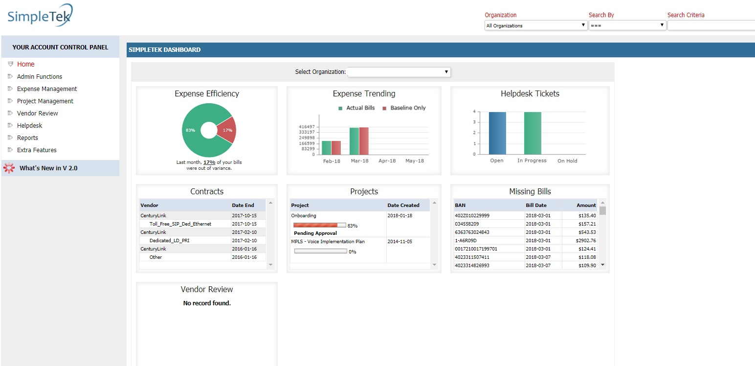
Show Me SimpleTek
Let’s Prove how SimpleTek
  Supports the MOST Services & Technology
  The BEST Mobility
  The BEST Vendor Administration & Contracts
  The BEST Reporting
  EASIEST To Use

Slide 16

Price Performance Leader
Affordable
  Up to 50% less than competitors
Automated
  Reduces manpower drain
  Reduces costly mistakes
FREE support
  Quick e-mail response
  Help Desk
  Excellent support library

Slide 17
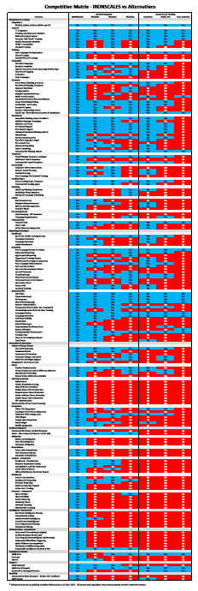
How Does It Compare
  Supports the MOST Services & Technology
  The BEST Mobility
  The BEST Vendor Administration & Contracts
  The BEST Reporting
  EASIEST To Use
Request the competitive matrix to see how SimpleTek compares

Slide 18
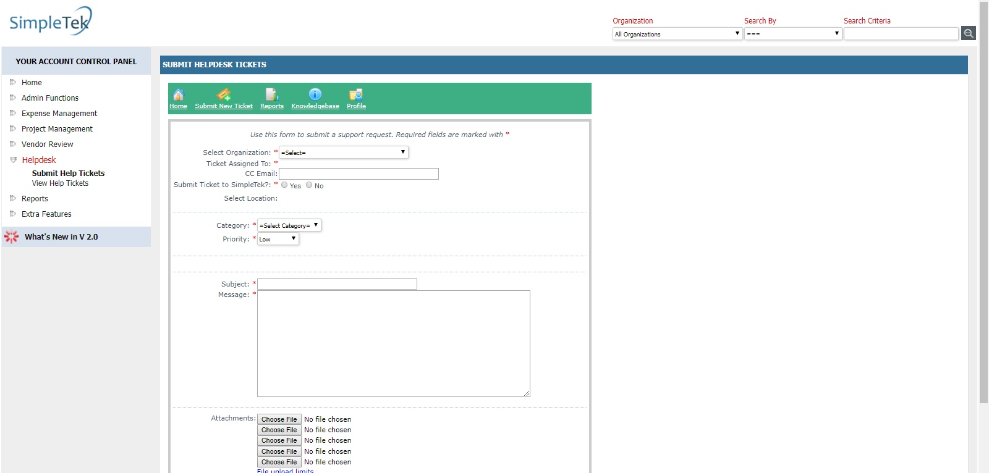
Testimonials
From Bill (Network Engineer) at an International Agricultural manufacturing company “There is NOTHING out there like this! I have been looking for three years and I have never been able to find anything that provides a single place to go to with all of my information, including help desk, bill processing and verification, which keeps track of all of my contracts, services and equipment. This frees up about 3 days a month because I don’t have to go searching for all this information anymore.”

Slide 19

Testimonials
“I retired from the Federal government prior to taking this position…(and) planned and managed the relocation of at least six government organizations. The one inevitability in each was that the installation of communications would always be the consumer of time and fraught with problems. This was not the case with SimpleTek…their professional staff have no peers.” - Lonnie (Operations Director) at a nationally recognized Not-for-Profit organization.
“I have been using the Simpletek application for a few weeks, trying to get a better understanding our telecom spend. I like the tool and find it user friendly.” -Jon, (VP of Infrastructure) at large List brokerage company.
This Photo by Unknown Author is licensed under CC BY-SA

Slide 20
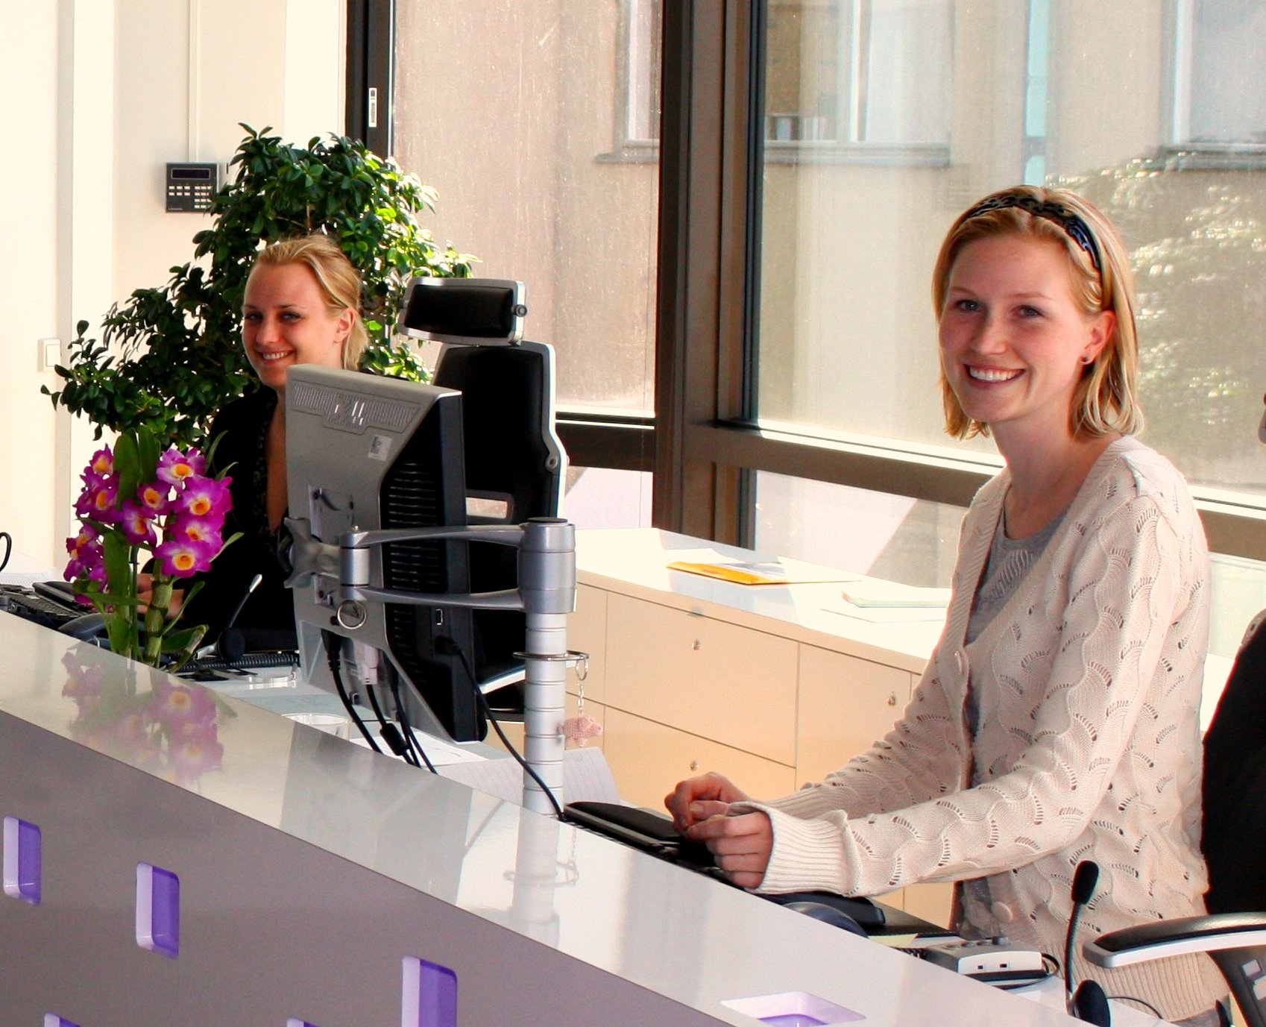
Testimonials
“The SimpleTek staff tracks down and resolves billing issues with our Telecom providers. The have identified services that were no longer being used providing a savings for us. They help negotiate new lower priced contracts. All of this has provided savings to us that are greater than the service fees paid to SimpleTek. Most importantly, this frees our staff to focus on other projects and tasks.” -Dan (Supervisor Networks) Large Coal Provider.

Slide 21


Testimonials
“So far we are at about $340K annual savings. I think we hit most of the big-ticket items, we are currently working our way through POTs lines.”-Gary (Director IT) at large List brokerage company.

Slide 22

Picture This!
This time you close an office, but instead of paying thousands for the internet and phone for years past the closure, you click “office closed” in SimpleTek. The system and team shuts everything off, but most important, the system flags if it returns—so you can quickly dispute it…and don’t keep paying (like you’ve doing for years)
Your phone service contract is up for auto-renewal. This time you get an early notification from the SimpleTek software. The dashboard shows you the most current rates and more features (much lower than what you have), but also competitive vendor rates—you have everything you need to re-negotiate the best rate (saving thousands)
Nothing slips through the cracks, you can manage the entire system in minutes (give the person a raise!)…
Life is Good!
This Photo by Unknown Author is licensed under CC BY-NC-ND

Slide 23

Next Steps
Call for more information
Get a free analysis
Get a quote
Buy Now

Slide 24

Questions & Answers

